Slide 1
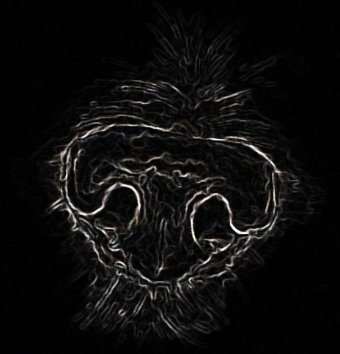
RUMYPET(R U my pet?)
Team Groza
Presentor:Kim Tae Hong (20132335)
Kim Chan Il (20150577)
Paeng Jin Wook (20154645)

Slide 2
Contents
Schedule & Progress
UI Design
Development Environment
Plans
Q&A

Slide 3
Week | To-Do (can be changed) | Progress
Week 1 | Project goal setting | Done
Week 2 | Propose project | Done
Week 3 | Design: User Interface, System Architectures Setting : Development Environment, | Done
Week 4 | Workshop for collecting data set( Dog cafe, park, .. etc)
Week 5 | Hong : developing AWS server environment. Paeng : preprocessing the dog’s nose picture using opencv. Chan : developing basic UI in application.
Week 6 | Hong : complete the developing basic Server Core Paeng : use various algorithms, confirm the each algorithm’s effect Chan : collect various data set
Week 7 | Hong : connect the server and application Paeng : connect the server and application Chan : develop the UI and database
Week 8 | Midterm Examination
Week 9 | Hong : sync with server Paeng : sync with client Chan : Intermediate check of our development status
Week 10 | Hong : complete the server and android application. Paeng : complete the Application UI Chan : complete the algorithm.
Week 11 | We will meet together and feedback each other’s code.
Week 12 | Hong : Implement improvement factor at Server Paeng : Implement improvement factor at algorithm Chan : Implement improvement factor at application UI
Week 13 | First Demonstration and feedback
Week 14 | First Revising our project
Week 15 | Final Demonstration
Week 16 | Final Examination
Schedule & Progress

Slide 4
Process of this Week
Week 3 | Design User Interface, System Architectures Setting : Development Environment

Slide 5

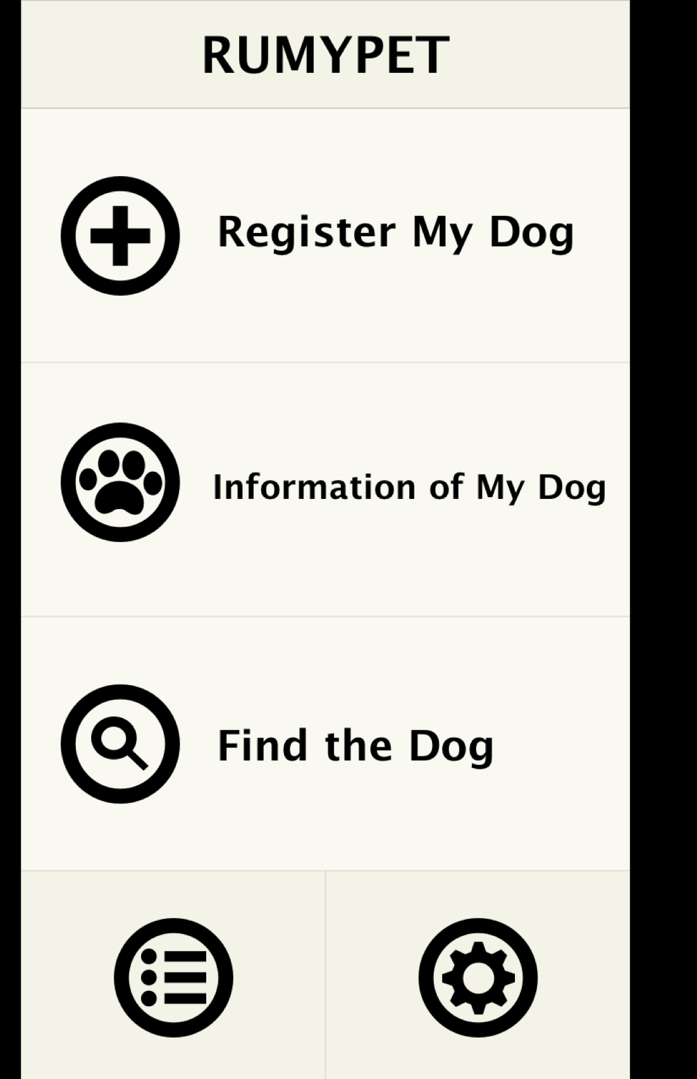
Main UI
Intro
Main

Slide 6
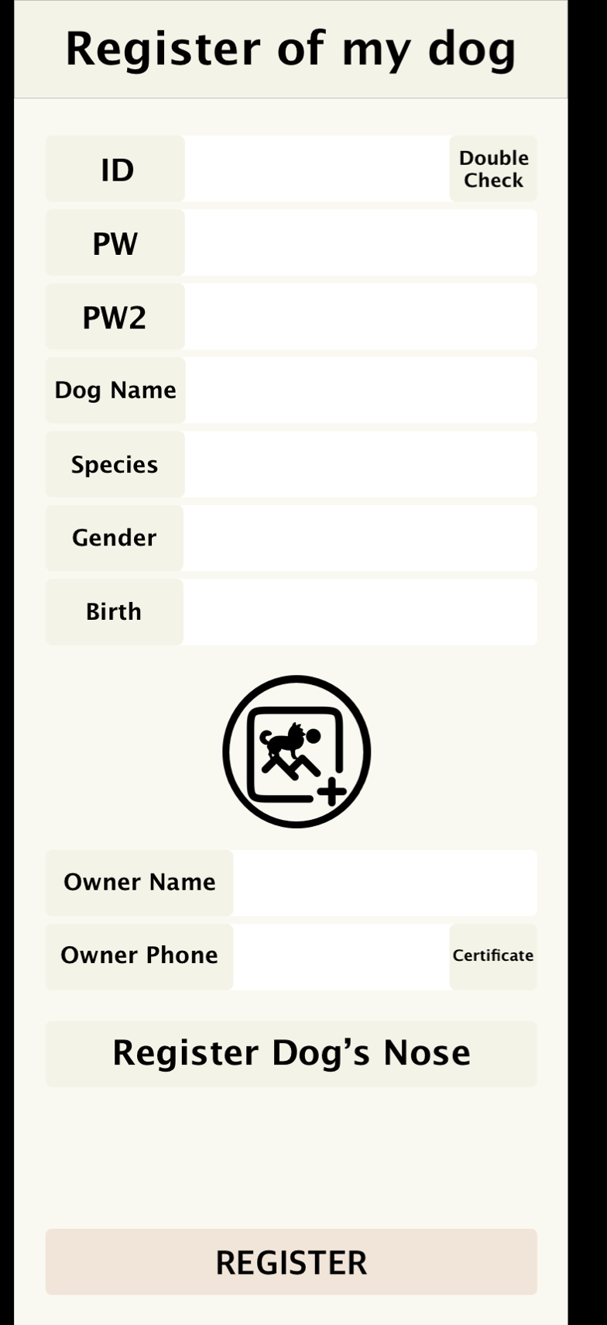
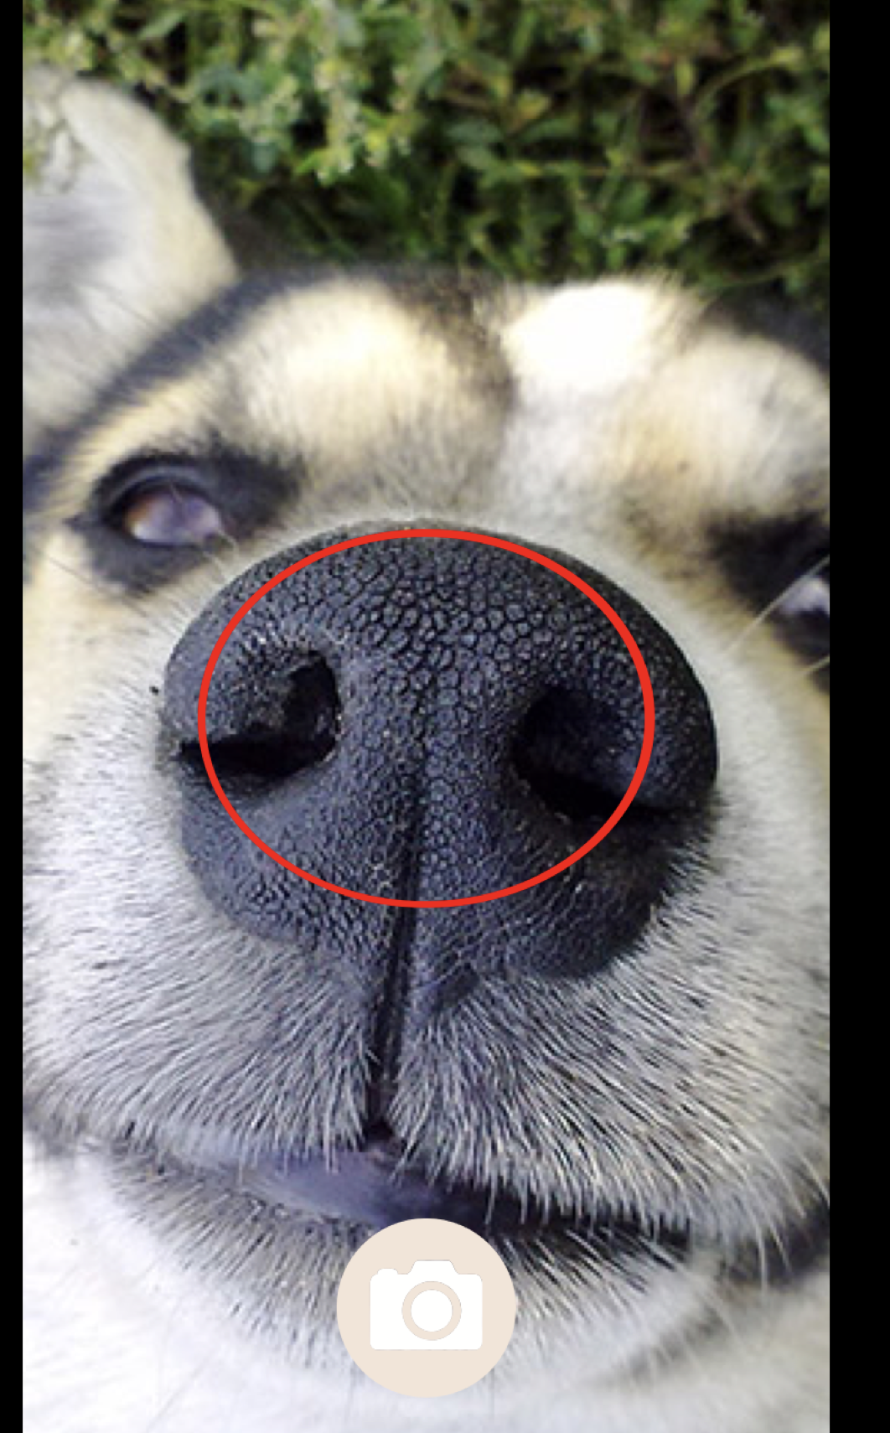
Register
Register Page
Register Dog’s nose

Slide 7
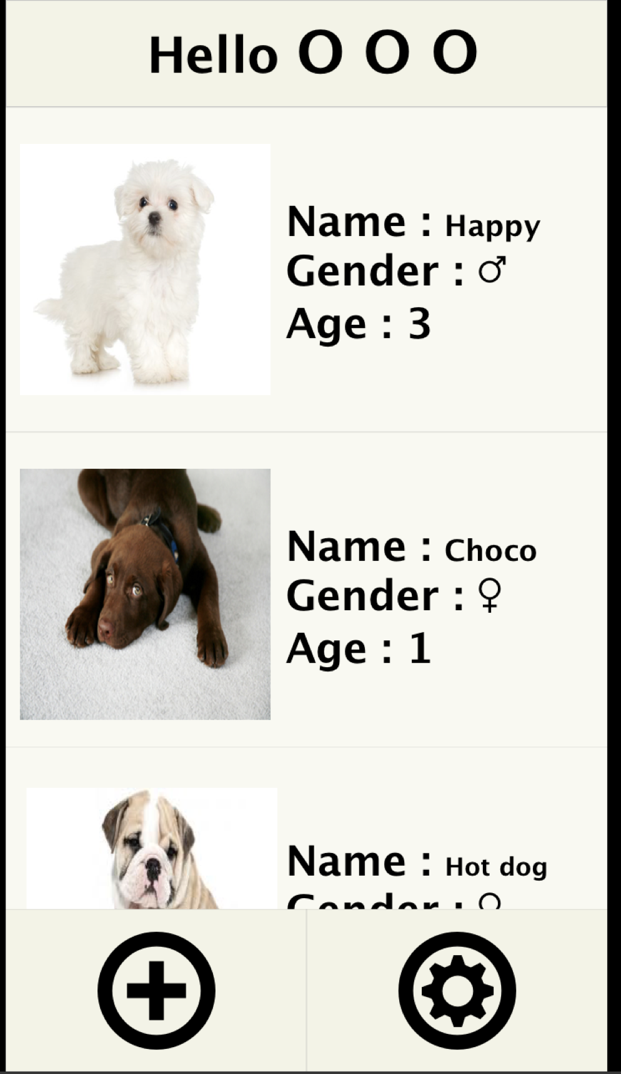
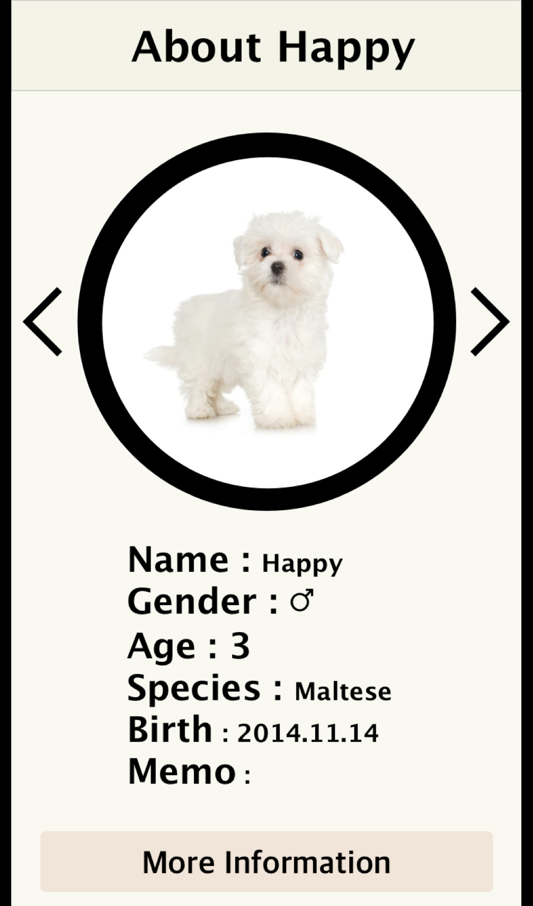
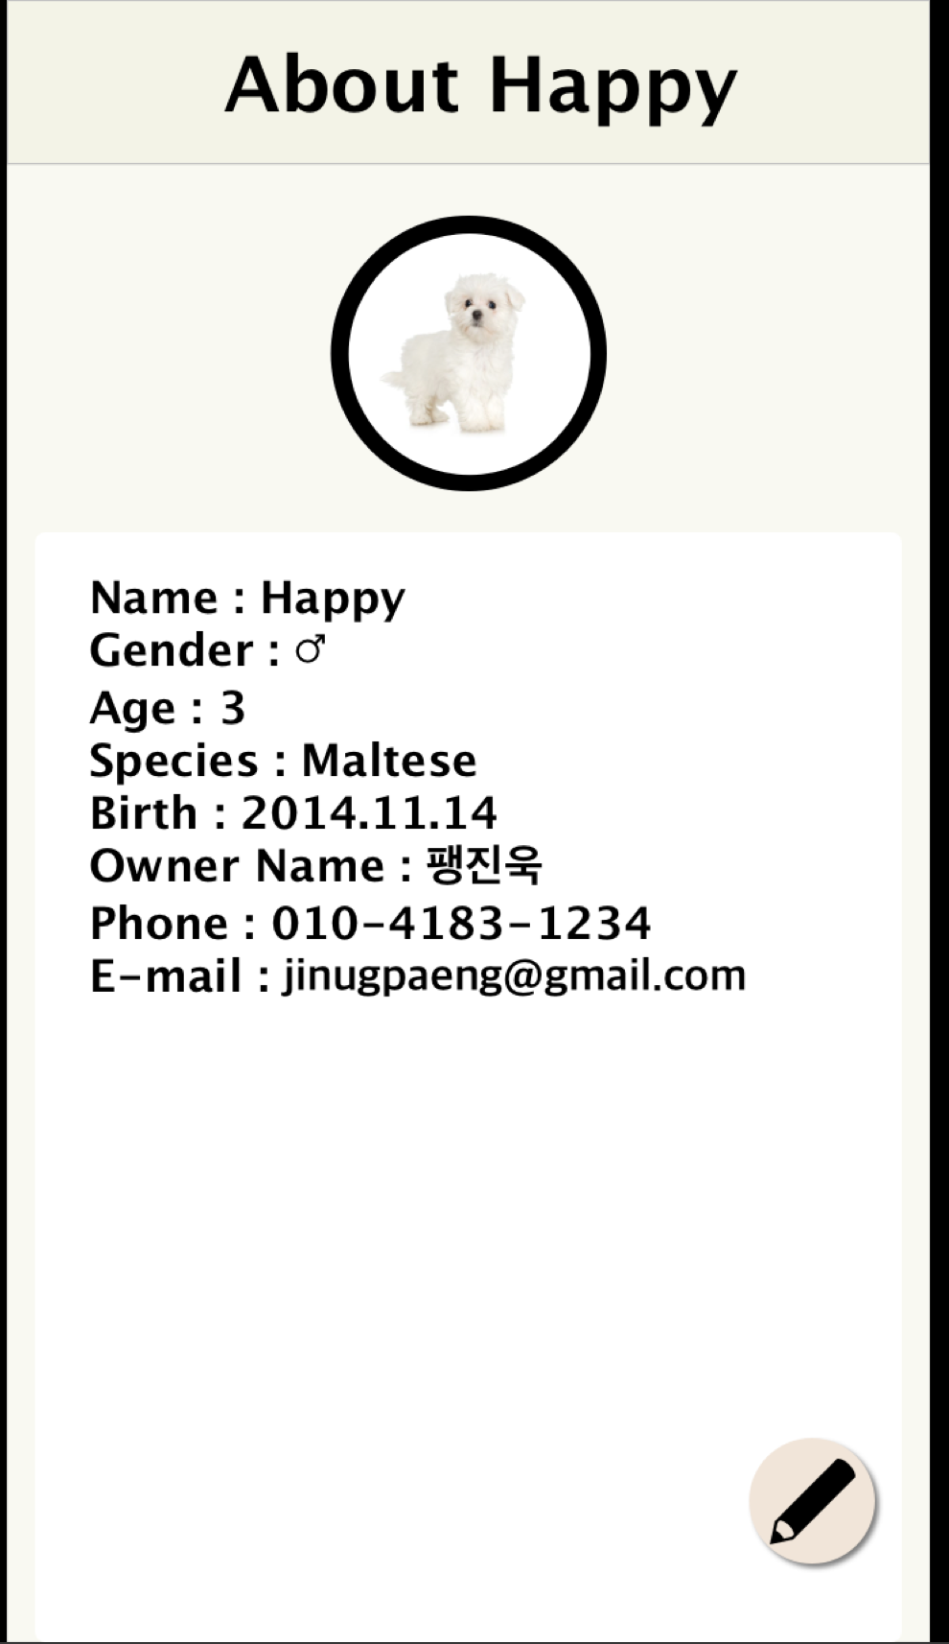
Information of my dog
Info of my Dogs
Info of my Dog
Certificating
Info of my Dog’s Detail

Slide 8

Find the dogs
Find the Dogs
Certificating
Info of my Dog’s Detail

Slide 9
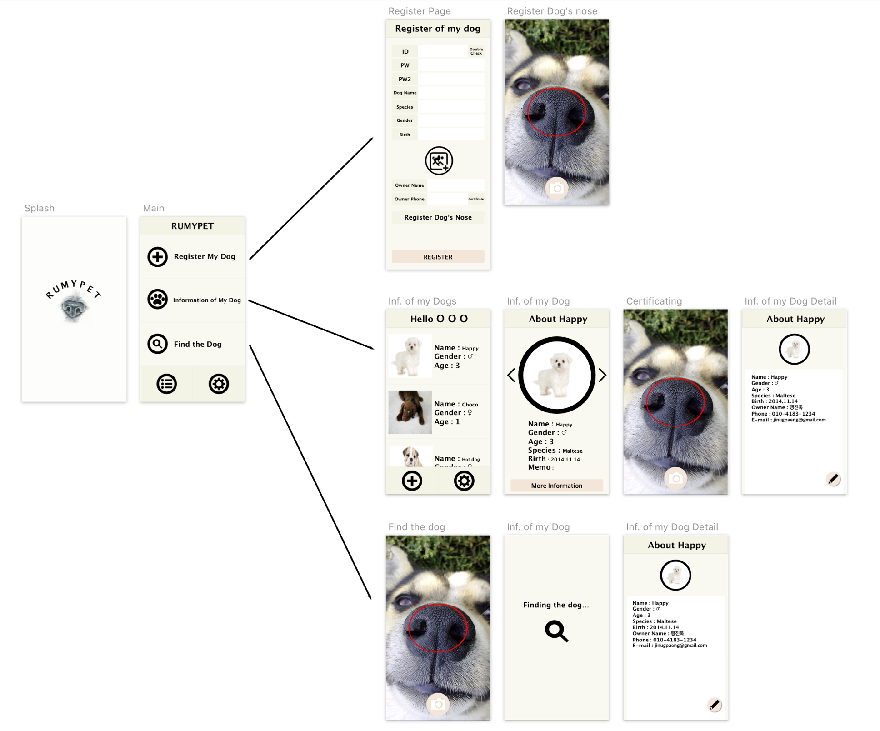
Scenario

Slide 10
OS | Mac OS 10.13.3
Development Tools | Android Studio 3.0.1, Pycharm 2017.3.4
Server | AWS EC2
Database Server | Mongo DB
Development Language | Python, Java
Setting Development Environment

Slide 11
Plans for Next Week
Week 4 | Workshop for collecting data set( Dog cafe, park, .. etc)
Week 5 | Hong : developing AWS server environment. Paeng : preprocessing the dog’s nose picture using opencv. Chan : developing basic UI in application.

Slide 12
Q&A

Slide 13
Thank You

